Slide 1
Tree Based Models

Slide 2

Journey Through The Woods
Decision Tree
Tuned Decision Tree
Bagged Tree
Random Forest
Tuned Random Forest
Stochastic Gradient Boost

Slide 3

My Very First Decision Tree
Parameters:
Max Depth = 5
All else default
R²
Training: 84%
Test: 75%
RMSE
Training: .1582
Test: .1938

Slide 4

Tuned Decision Tree ( using GridSearchCV)
Best Parameters
Max Depth: 11
Min Samples Leaf: 8
R²
Training: 91%
Test: 77%
RMSE
Training: .1192
Test: .1854
THOUGHTS: We have only fit the tree on one set of observations. Lower the variance by fitting the tree on MULTIPLE sets of observations using a Bagged Decision Tree.

Slide 5
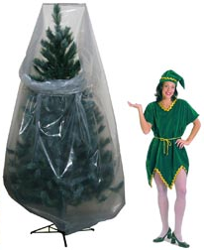
Bagged Tree
Parameters
Trees: 500
Max Samples: 783 (2/3rds of training set)
R²
Training: 97%
Test: 87%
RMSE
Training: .0745
Test: .1394
THOUGHTS: Training and Test scores were improved but trees are too correlated as we are using the same set of parameters. Take subset of predictors at each split to decorrelate the trees using Random Forest.

Slide 6
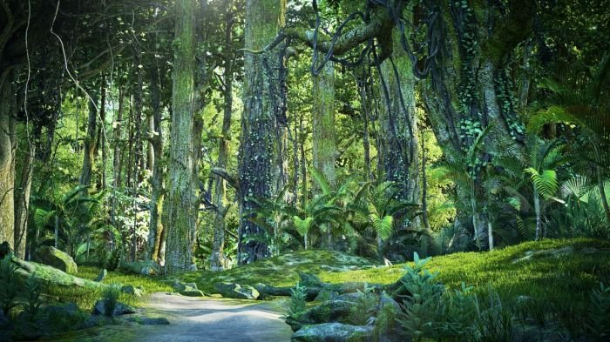
My Very First Random Forest
Parameters
Trees: 500
Max features: 17 (~ sqrt # of predictors)
R²
Training: 98%
Test: 87%
RMSE
Training: .0538
Test: .1397
THOUGHTS: Things barely changed (slight improvement) in the results between the Bagged Tree and the Random Forest model. But what DID change were the importance to each predictor.

Slide 7
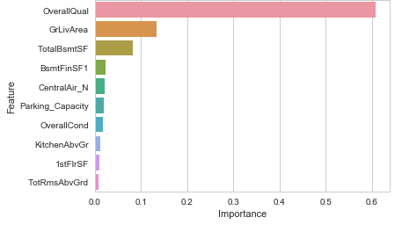
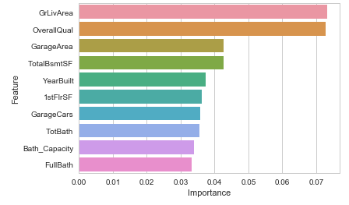
Top 10 Variable Importance Comparison
Correlated Trees (Bagged Tree)
Non Correlated Trees (Random Forest)

Slide 8
Tuned Random Forest (with GridSearchCV)
Best Parameters
Max Features: 500
Max Features: 36
R²
Training: 98%
Test: 88%
RMSE
Training: .0526
Test: .1361
THOUGHTS: Again, not much changed for the Training and Test R² . What’s going on?

Slide 9

Stochastic Gradient Boosting
Parameters
Learning Rate: 0.1
Subsample = 2/3
R²
Training: 96%
Test: 92%
RMSE
Training: .0835
Test: .1125
THOUGHTS: Woah! Major improvements to the test scores and RMSE.

Slide 10
Tuned Stochastic Gradient Boosting (using GridSearchCV)
Best Parameters
Trees: 800
Learning Rate: 0.04
Subsample = 2/3
R²
Training: 99%
Test: 93%
RMSE
Training: .0454
Test: .1036
THOUGHTS: Is this right…

